Slide 1
Predictive Modeling for Early Intervention: Developing a Diabetes Risk Classification System
Name | Matrix No. | Roles
Tan Kai Qi | 23051355 | Leader
Alicia Chua Yang Qin | 23060317 | Oracle
Che Jia Min | 23053571 | Detective
Ng Chee Kang | 23051336 | Secretary
Sang Yong Han | 22087278 | Maker

Slide 2
Executive Summary
Aims to :
Identify a robust classification model for predicting an individual's risk of developing diabetes based on a set of provided attributes
Enable early intervention by identifying individuals at a high risk of diabetes
Identify prevention efforts by providing actionable insights to individuals, healthcare professionals, and public health authorities
O
S
E
M
N
Obtain Scrub Explore Model Interpret

Slide 3
Modelling

Slide 4
Model
Logistics Regression
Random Forest

Slide 5
Logistics Regression
LR is the ideal tool for the classification with our data.
Variables: gender, polyuria, polydipsia, sudden weight loss, polyphagia, irritability, and partial paresis.
Dataset divided it into an 80% training set and a 20% testing set for modelling.

Slide 6
Logistics Regression
First logistics Regression model included all variables.
There are two variables are lower correlations to diabetes: Polyphagia and Partial Paresis.
Build a second simplified mode excluded the two variables.
Aimed to test the robustness of our model and increase the accuracy with fewer predictors.

Slide 7
Logistics Regression - Cross Validation
K-fold Cross Validation - 10-fold
It assess the models' performance to ensure the results are not just a consequence of a particular data split.

Slide 8
Random Forest
To uncover any other model that might predict diabetes more effectively.
The characteristics of random forest match our objective, and it also able to manage complex data and reduce overfitting.
Two versions: model_rf_full and model_rf_simplified.

Slide 9
Random Forest – Fine Tuning
Number of trees: N500 vs N600.
Mtry:
1, 3, 5, 7 for full variables random forest
1, 3, 5 mtry for simplified random forest model.

Slide 10
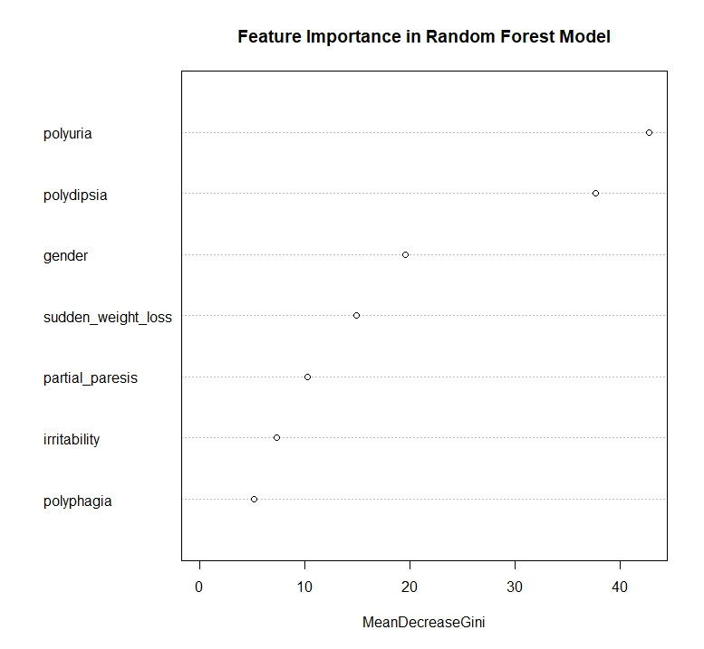
Feature Importance Analysis
Logistics Regression : Coefficient Estimates
Significant coefficients: gender, polyuria, polydipsia.
Random Forest: "varImpPlot" function

Slide 11
Data Interpretation

Slide 12
Logistic Regression
Two logistic regression models:
Full-featured model (include all selected variables)
Accuracy: 90.38%
AUC: 0.971
Simplified model (excluded polyphagia and partial paresis due to low correlation (not significant)
Accuracy: 92.31%
ROC: 0.9718
An increase in accuracy from 90.38% to 92.31%
May be due to removal of non significant features→ noise reduction
Indicates that our model is robust even with fewer predictors
Achieved our first objective

Slide 13
K-fold cross-validation
10-fold→ higher number of folds→ advantageous for smaller datasets
Create diverse training and testing subsets
Full-featured LR model
Average AUC: 0.9623517
Simplified LR model
Average AUC: 0.9604677
Both models performed well on different data subsets → high AUC values
Validating the robustness and generalization ability of our models

Slide 14
Random Forest
Two random forest models:
Full-featured model (include all selected variables)
Accuracy: 92.31%
Simplified model (excluded polyphagia and partial paresis )
Accuracy: 91.35%
A slight decrease in accuracy from 92.31% to 91.35%
Removing some variables → information loss
Simplified LR model and Full-featured RF model showed the highest accuracy (92.32%)
May be due to the different complexity of the models

Slide 15
Fine-tuning of Random Forest parameters
Number of trees
500 trees increased to 600 trees
Showed same accuracy levels as the models with 500 trees
Increase in number of trees has no effect on accuracy
May be because performance has reached a plateau, minimal improvement in AUC
mtry
Full-featured model
mtry values of 5 and 7 obtained the highest accuracy (94.23%)
mtry value of 7 is more optimal → lower Out-of-Bag (OOB) error
Low OOB→ good performance and can perform well on new, unseen data
Simplified model
mtry values 3 and 5 demonstrated equal accuracy (91.35%)
mtry value of 3 is better than mtry value of 5 → a lower OOB error

Slide 16
Feature Importance analysis
For both logistic regression and random forest models:
Most significant features = polydipsia, polyuria, gender
High blood sugar levels → increased pressure on kidneys → produce more urine (polyuria)
Excessive urination → dehydration → increased thirst (polydipsia)
Relationship between gender and diabetes may be linked to the amount of visceral fat in the body
Identification of significant risk factors → early healthcare interventions → better health outcomes

Slide 17
Plan for Reproducible Research

Slide 18
Plan for Reproducible Research
1. Obtain
The diabetes dataset is obtained from Kaggle.
2.Scrub
Dplyr package from R is use for data cleaning.
3.Explore
- Using Pearson correlation coefficient to quantify the relationship between the variables.
-Using Chi-Squared to
provide statistical solid support.
4.Model
-Logistic Regression Model and Random Forest Model
-Divided dataset into training and testing based on 80:20.
-Using 10-fold-cross-validation to examine it robustness and reliability in predicting modeling
5.Interpret
-Review the outcome of the model.
- Document conclusions drawn from the analysis

Slide 19
Plan for Reproducible Research (con’t)
All the code used in this project can be found in below link:
kaiqi96/WQD7001_PDS_G8 (github.com)
The link captured all changes made over the project time which allow user to trace the evolution of the project.
By following these steps and maintaining detailed documentation, clear code and providing access to the necessary resources, increase likelihood to reproduce the result.

Slide 20
Deployment

Slide 21
Data Product
Why?
End User Feedback
User-friendly
Data-driven application
shinyapps.io
https://kaiqi96.shinyapps.io/WQD7001_GA2_G8/
User 1 (healthcare sector): A user-friendly system to predict the risk of diabetes. Great tool for quick health checking and providing awareness on diabetes.
User 2: This diabetes predictor is straightforward. However, it would be even better if there were more details on how certain features are weighted in the prediction.
User 3: The diabetes predictor is incredibly helpful! It provided me with a quick assessment of my risk for diabetes. The interface is user-friendly and motivates me to adopt a healthier lifestyle to reduce my risk.

Slide 22
Insights + Conclusion

Slide 23
Polyuria, polydipsia, and irritability identified as top early warning signs of diabetes risk 🚨
Body composition (BMI, waist size) major driver - highlights importance of weight management 🏋️‍♀️
Machine learning model demonstrates feasibility of accurate diabetes risk prediction to enable preventive care 💻
Model has 92% accuracy; validated for usage as data-driven screening tool to trigger timely interventions ✅
Prevents disease onset through counseling for lifestyle changes for high-risk groups 👨‍⚕️👩‍⚕️
Significant cost savings potential from early diagnosis and reduction in disease burden 💰
More data over time expected to make model even more robust and generalizable 📈
Overall demonstrates potential of AI/ML for predictive healthcare and targeted interventions 🤖

Slide 24
Thanks!

